Slide 1

Smart IoT Enabled Intelligent –Health Medicine Device
Domain - Networking II domain
Arpana Arland(RA1511004010706)
Sushant Kumar(RA1511004010713)
Nitin Asthana(RA1511004010717)
Prateek Srivastava (RA1511004010721)
Project Co-ordinator : Project Guide :
Dr. J Subhashini Mrs. V Padmajothi
Assistant Professor(S.G) Assistant Professor(Sr.G)
Dept. of ECE SRM IST Kattankulathur Dept. of ECE SRM IST Kattankulathur

Slide 2
Index
Abstract
Objective
Problem Statement
Literature Review
Novelty
System/Architecture diagram
Hardware description and circuit diagram
Flow chart/ methodology
Hardware Specifications
Software Specifications
Review Progress
Applications
Conclusion
Future work
References

Slide 3
Abstract
It is helpful to people who are forgetful about taking medicine in proper time, especially the elderly people.
It can be used by nurses as well to avoid confusion in medication of patients.
The time required to take medicine isn’t printed on medicine box or can’t be read by people.
Sometimes they forget to take pills.
This project deals with particular time a patient needs to take pills which can be changed according to his requirement.
It even ensures that right medicine at appropriate time is taken, moreover it monitors the number of pills left, if few, order of pill is sent by system to medical shop automatically through GSM.

Slide 4
Objective
To maintain the schedule of taking medicine.
Helpful for old person who have weak memory.
Helpful for nurses who get confused in giving medicine to her number of patient.
It maintains the regularity of taking medicine and due to this patient can complete course of medicine easily.
Single device can handle number of patient that is why it is cheap and best.

Slide 5
Problem Statement
Elderly people are forgetful of their medications and nurses get confused about medication of different patients. The appropriate time of dosage of medicine isn’t stated on the medicine box hence should be careful regarding that.

Slide 6
Literature Review
[1] An IoT-Aware Architecture for Smart Healthcare Systems. Luca Catarinucci, Danilo De Donno, Luca Mainetti ,IEEE Internet of Things Journal, Nov 2015.
Automatic monitoring and tracking of patients, personnel, and biomedical devices with a complex network infrastructure relying on a CoAP, 6LoWPAN, and REST paradigms has been implemented
[2] A Health-IoT Platform Based on the Integration of Intelligent Packaging, Unobtrusive Bio-Sensor and Intelligent Medicine Box. Geng Yang, Li Xie, Matti Mäntysalo, Xiaolin Zhou, IEEE Transactions on Industrial Informatics, November 2014.
IoT-based intelligent home-centric healthcare platform connects smart sensors attached to human body for

Slide 7
physiological monitoring and pharmaceutical packaging for daily medication.
[3] An Electronic Pillbox for Continuous Monitoring of Medication Adherence, Tamara. L. Hayes John, M. Hunt, Andre Adami, and Jeffrey A. Kaye, IEEE Engineering in Medicine and Biology Society, October 2012.
“Magic Medicine Cabinet” which used RFID to identify which medications were taken out of a cabinet, face recognition to identify who approached the device, and a broadband connection to be able to provide an integrated “situation health portal”. Thus, users were required to use the medicine cabinet and to store all medications in separate bottles that could be RFID tagged.

Slide 8
[4] Reconfigurable Smart Factory for Drug Packing in Healthcare Industry 4.0. Jiafu Wan, Shenglong Tang, Di Li, Muhammad Imran, Chunhua Zhang, Chengliang Liu, Zhibo Pang, IEEE Transactions on Industrial Informatics Oct 2018.
Industry 4.0, which exploits Cyber-Physical Systems (CPS) and represents digital transformation of manufacturing, is deeply affecting healthcare as well as other traditional production sector. To accommodate the increasing demand of agility, flexibility, and low cost in healthcare sector, a data-driven reconfigurable production mode of Smart Factory for pharmaceutical manufacturing is proposed in this paper. The architecture of the Smart Factory is consisted of three primary layers, namely perception layer, deployment layer and executing layer.

Slide 9
[5] Effective ways to use Internet of Things in the field of medical and smart health care. Kaleem Ullah ; Munam Ali Shah ; Sijing Zhang , IEEE Xplore 23 May 2016.
The Internet of Things (IoT) is a new concept that allows users to connect various sensors and smart devices to collect real-time data from the environment. However, it has been observed that a comprehensive platform is still missing in the e-Health and mHealth architectures to use smartphone sensors to sense and transmit important data related to a patient’s health. In this paper contribution is made twofold. The existing literature has been critically evaluated, which discusses the effective ways to deploy IoT in the field of medical and smart health care.

Slide 10
Novelty
This project incorporates RFID tag and reader to ensure encryption such that pills are not misplaced and taken at wrong time. The use of sensors enables to indicate number of pills with LCD displaying an alert of its completion. It enables patient to generate an emergency message to hospital and relative using GSM. The use of RTC helps patient to take medicine in time. The prescriptions and detailed medical history of patient can be accessed and updated through cloud.

Slide 11
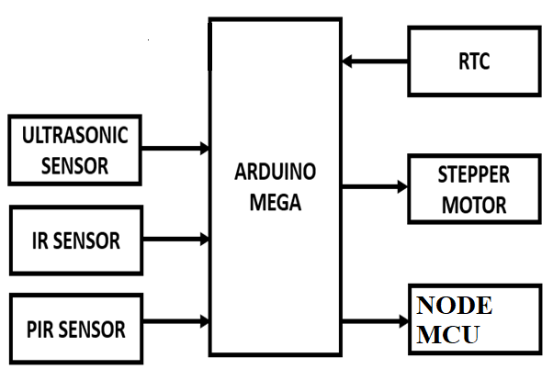
System/Architecture diagram

Slide 12
Hardware used :
Arduino mega
WiFi module
Ultrasonic sensor
PIR sensor
IR sensor
RTC module

Slide 13
Software used :
Arduino IDE(Integrated Development Environment)
Arduino C

Slide 14
Hardware description and circuit diagram
Arduino Mega:- The Arduino MEGA 2560 has 54 digital I/O pins, 16 analog inputs and a larger space for your sketch it is the recommended board for 3D printers and robotics projects.
Ultrasonic sensor:- Ultrasonic transducers are used in systems which evaluate targets by interpreting the reflected signals.
IR sensor:- An IR sensor can measure the heat of an object as well as detects the motion.
Real time clocks (RTC):- The DS1307 real time clock (RTC) IC is an 8 pin device. The clock/calendar provides seconds, minutes, hours, day, date, month and year qualified data.

Slide 15
NodeMCU:-NodeMCU is an open source IoT platform. It includes firmware which runs on the ESP8266 Wi-Fi SoC from Espressif Systems, and hardware which is based on the ESP-12 module.

Slide 16
Software Specification
Arduino IDE:- The open-source Arduino Software (IDE) makes it easy to write code and upload it to the board. It runs on Windows, Mac OS X, and Linux. The environment is written in Java and based on Processing and other open-source software. This software can be used with any Arduino board.
Arduino C :- The microcontrollers are typically programmed using a dialect of features from the programming languages C and C++.

Slide 17
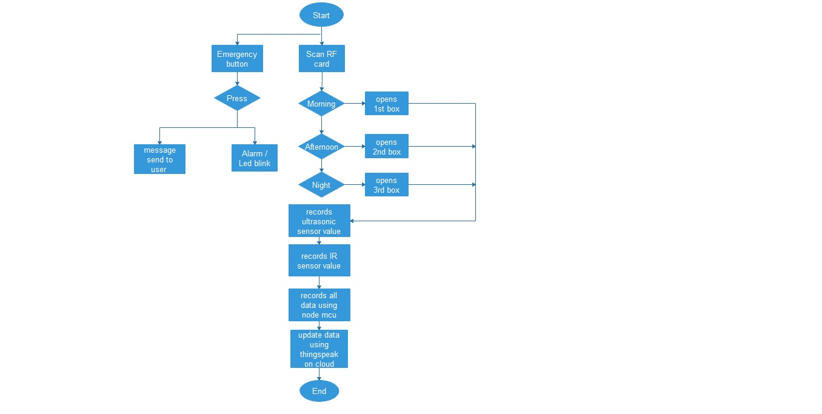
Flow chart/ methodology

Slide 18
Coding
#include <swRTC.h>swRTC rtc; //create a new istance of the libvoid setup()
{
rtc.stopRTC(); //stop the RTC
rtc.setTime(12,23,0); //set the time here
rtc.setDate(7,3,2019); //set the date here
rtc.startRTC(); //start the RTC
Serial.begin(19200); //choose the serial speed here
delay(2000); //delay to let the user opens the serial monitor
}void loop()
{
Serial.print(rtc.getHours(),
DEC);
Serial.print(":");
Serial.print(rtc.getMinutes(),
DEC);
Serial.print(":");
Serial.print(rtc.getSeconds(),
DEC);
Serial.print(" -- ");
Serial.print("Timestamp: ");
Serial.println(rtc.getTimestamp(),
DEC);if(rtc.getHours() == 12 && rtc.getMinutes() ==23 )
{if(Serial.available() > 0)
{ String c;
c = Serial.readString();// if data available from reader
Serial.print(c);
if(c == "$0001630441"){Serial.println("ID1");
}
}
}
if(rtc.getHours() == 12 && rtc.getMinutes() == 25)
{
if(Serial.available() > 0)
{
String c;
c = Serial.readString();// if data available from reader
Serial.print(c);
if(c == "$0001630441"){Serial.println("ID1");
}
}
}
if(rtc.getHours() == 12 && rtc.getMinutes() == 27 )
{
if(Serial.available() > 0)
{
String c;
c = Serial.readString();// if data available from reader
Serial.print(c);
if(c == "$0001630441"){Serial.println("ID1");
}
}
}
}

Slide 19
CODE FOR SENSORS
#include "UbidotsMicroESP8266.h"
#include <ESP8266WiFi.h>
#define TOKEN "A1E-ii2tqV8yW3FaUM21UiZJcurFhuKzzj" // Put here your Ubidots TOKEN
#define ID_1 "5c7e27a8c03f976d01ce4966" // b1
#define ID_2 "5c7e27cac03f976d3a5f60cf" // b2
#define ID_3 "5c7e27d1c03f976d01ce496e" // b3
#define ID_4 "5c7e27d9c03f976d3a5f60ef" // c1
#define WIFISSID "admin" // Put here your Wi-Fi SSID
#define PASSWORD "12345678" // Put here your Wi-Fi password
int pirPin = D8; //digital 2
int counter = 0;
int state;
int laststate = HIGH;
const int trigPin1 = D1;
const int echoPin1 = D2;
const int trigPin2 = D3;
const int echoPin2 = D4;
const int trigPin3 = D5;
const int echoPin3 = D6;
long duration1;
int distance1;
long duration2;
int distance2;
long duration3;
int distance3;
Ubidots client(TOKEN);
void setup() {
Serial.begin(115200);
client.wifiConnection(WIFISSID, PASSWORD);
pinMode(trigPin1, OUTPUT); // Sets the trigPin as an Output
pinMode(echoPin1, INPUT); // Sets the echoPin as an Input
pinMode(trigPin2, OUTPUT); // Sets the trigPin as an Output
pinMode(echoPin2, INPUT); // Sets the echoPin as an Input
pinMode(trigPin3, OUTPUT); // Sets the trigPin as an Output
pinMode(echoPin3, INPUT); // Sets the echoPin as an Input
pinMode(pirPin, INPUT);
}
void loop() {
int state = digitalRead(pirPin);
if ( state != laststate)
{
counter = counter + 1;

Slide 20
Serial.println("counter");
Serial.println(counter);
}
laststate = state;
delay(0);
digitalWrite(trigPin1, LOW);
delayMicroseconds(2);
digitalWrite(trigPin1, HIGH);
delayMicroseconds(10);
digitalWrite(trigPin1, LOW);
duration1 = pulseIn(echoPin1, HIGH);
distance1 = duration1 * 0.034 / 2;
digitalWrite(trigPin2, LOW);
delayMicroseconds(2);
digitalWrite(trigPin2, HIGH);
delayMicroseconds(10);
digitalWrite(trigPin2, LOW);
duration2 = pulseIn(echoPin2, HIGH);
distance2 = duration2 * 0.034 / 2;
digitalWrite(trigPin3, LOW);
delayMicroseconds(2);
digitalWrite(trigPin3, HIGH);
delayMicroseconds(10);
digitalWrite(trigPin3, LOW);
duration3 = pulseIn(echoPin3, HIGH);
distance3 = duration3 * 0.034 / 2;
Serial.print("b1");
Serial.print("\t");
Serial.print("b2");
Serial.print("\t");
Serial.println("b3");
Serial.print(distance1);
Serial.print("\t");
Serial.print(distance2);
Serial.print("\t");
Serial.println(distance3);
delay(1000);
client.add(ID_1,distance1);
client.add(ID_2,distance2);
client.add(ID_3,distance3);
client.add(ID_4,counter);
client.sendAll(false);
delay(1000);
}

Slide 21
Algorithm
Coding for the setup is run.
RFID tag is scanned.
Servomotor rotates hence box opens.
Hand is put inside box.
It is assumed that only one pill is taken out each time hand is placed inside box.
Sensors(PIR,Ultrasonic) measures reading and updates it.
This information of sensors is sent to cloud through Nodemcu.
In case of emergency, patient presses emergency button which sends message to concerned person through GSM.

Slide 22
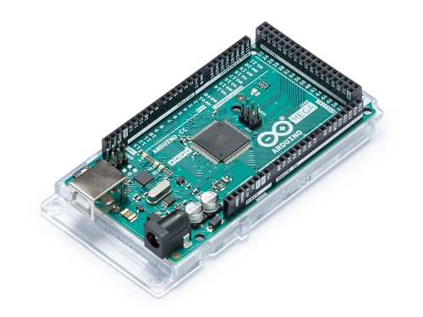
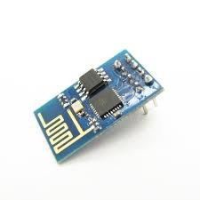
Hardware Specification
ARDUINO MEGA 2560 REV3
WiFi Module - ESP8266

Slide 23
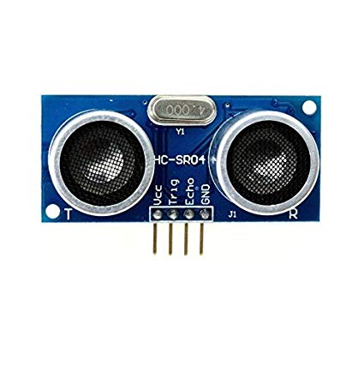
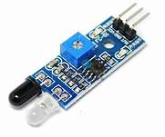
ULTRASONIC SENSOR MODULE SR-04
IR SENSOR

Slide 24
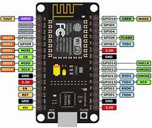
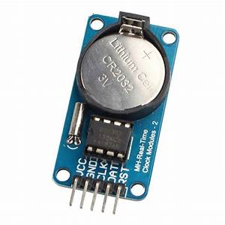
NodeMCU
Robodo Electronics MO52 DS3231 AT24C32 IIC Precision RTC Real Time Clock Memory Module Arduino Rpi Mcu

Slide 25
Applications
It reminds patient to take medicine on time.
This smart medicine box updates the quantity of medicine left in the box each time the patient takes a medicine.
In case of emergency the patient can directly contact to hospital and relatives using GSM module.
In case the patient misses his drug,he will be notified using an alarm.
This smart medicine box can be used to monitor the consumption of a particular drug in a particular area. Thus the number of patients suffering from a particular disease can easily be estimated by concerned agencies.

Slide 26
Realistic Constraints
Since the ultrasonic sensor on opening the box measures inaccurate reading because of its position, we're trying to correct it's reading in coding simulation such that it takes reading only when the box is closed.
It is assumed that whenever a hand is placed inside the box, only 1 pill has been taken out for sure.

Slide 27
Conclusion
The goal of our project is to provide healthy and tension free life to those users who are regularly taking pills and to provide this product at affordable cost.
Our product is so useful that there will be no need of taking care of these patients so care provider has no tension about their health to lead healthy and tension free life.

Slide 28
Future Work
In the future, we hope that this smart medicine box can be to linked to the online med karts, if in case the tablets are empty it directly sends a prescription message to the med kart in which they can help us delivering the prescribed tablets to our door step.
We can also try connecting our smart phones and smart devices to the medicine box so it can keep a track of the patient's routine like his daily movement, heartbeat, blood pressure etc.

Slide 29
References
An IoT-Aware Architecture for Smart Healthcare Systems. Luca Catarinucci, Danilo De Donno, Luca Mainetti ,IEEE Internet of Things Journal, November 2015.
A Health-IoT Platform Based on the Integration of Intelligent Packaging, Unobtrusive Bio-Sensor and Intelligent Medicine Box. Geng Yang, Li Xie, Matti Mäntysalo, Xiaolin Zhou, IEEE Transactions on Industrial Informatics, November 2014.
An Electronic Pillbox for Continuous Monitoring of Medication Adherence, Tamara. L. Hayes John, M. Hunt, Andre Adami, and Jeffrey A. Kaye, IEEE Engineering in Medicine and Biology Society, October 2012.
Reconfigurable Smart Factory for Drug Packing in Healthcare Industry 4.0. Jiafu Wan, Shenglong Tang, Di Li, Muhammad Imran, Chunhua Zhang, Chengliang Liu, Zhibo Pang, IEEE Transactions on Industrial Informatics Oct 2018.

Slide 30
Effective ways to use Internet of Things in the field of medical and smart health care. Kaleem Ullah ; Munam Ali Shah ; Sijing Zhang , IEEE Xplore 23 May 2016.

Slide 31
RESULT
Majority of the people may it be elderly or middle age person found it to be useful
Patient were able to maintain consistency of medication without fail
With the help of proper medication at proper time, people recovered soon
Elderly people found it to be friendly for use

Slide 32
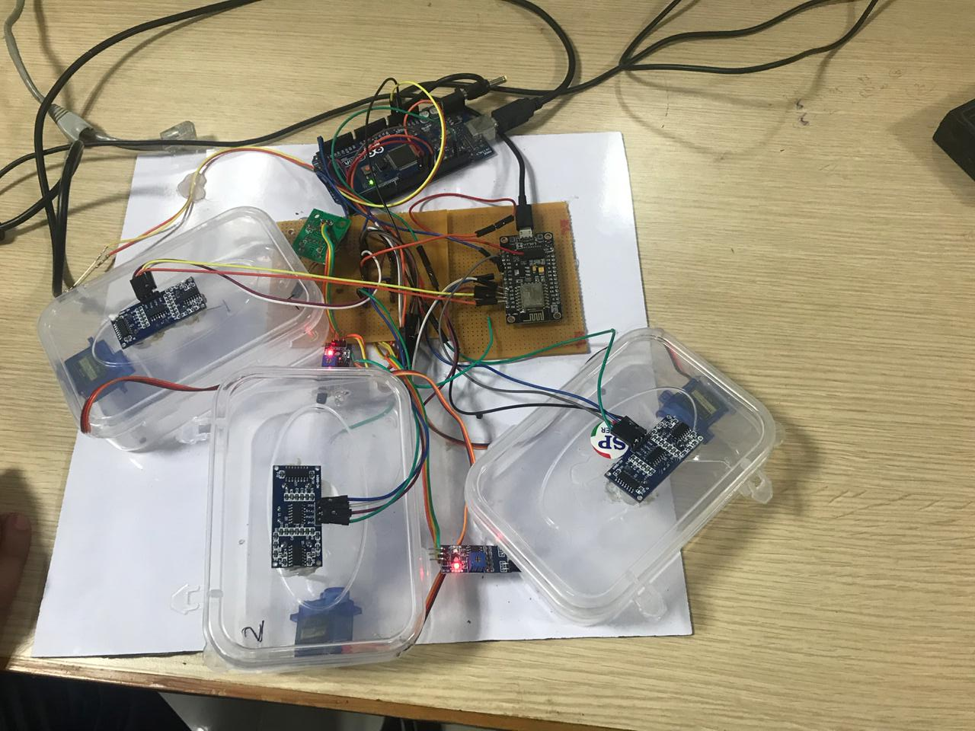
Project Image

Slide 33
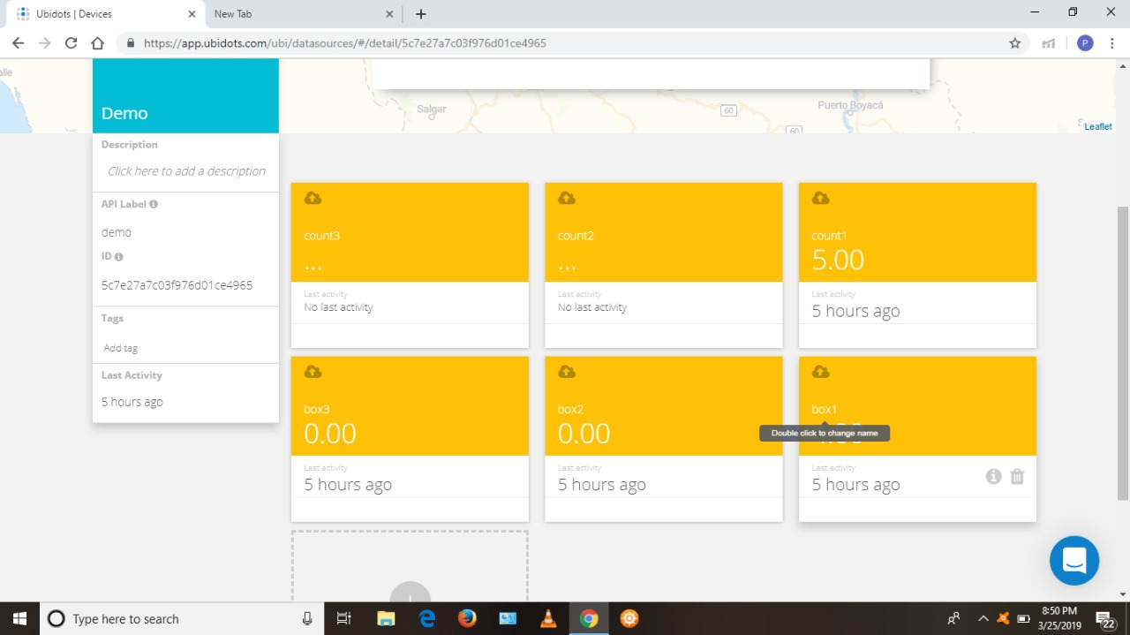

Slide 34


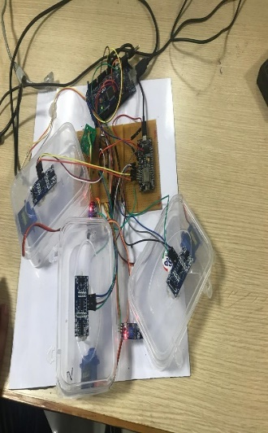

SMART IoT ENABLED INTELLIGENT – HEALTH MEDICINE DEVICE
ARPANA ARLAND, SUSHANT KUMAR, NITIN ASTHANA, PRATEEK SRIVASTAVA
ABSTRACT
WORKING FLOW CHART
RESULT
It is helpful to people who are forgetful about taking medicine in proper time, especially the elderly people.
It can be used by nurses as well to avoid confusion in medication of patients.
The time required to take medicine isn’t printed on medicine box or can’t be read by people.
Sometimes they forget to take pills.
This project deals with particular time a patient needs to take pills which can be changed according to his requirement.
It even ensures that right medicine at appropriate time is taken, moreover it monitors the number of pills left, if few, order of pill is sent by system to medical shop automatically through GSM.
Majority of the people may it be elderly or middle age person found it to be useful
Patient were able to maintain consistency of medication without fail
With the help of proper medication at proper time, people recovered soon
Elderly people found it to be friendly for use
INTRODUCTION
Drugs, the most common medical intervention, are an important part of medical care for older people. Without drugs, many older people would function less well or die at an earlier age. Older people tend to take more drugs than younger people because they are more likely to have more than one chronic medical disorder, such as high blood pressure, diabetes, or arthritis. Most drugs used by older people for chronic disorders are taken for years. Other drugs may be taken for only a short time to treat such problems as infections, some kinds of pain, and constipation. This medicine box is helpful to people who are forgetful about taking medicine in proper time, especially the elderly people. It can be used by nurses as well to avoid confusion in medication of patients. The time required to take medicine isn’t printed on medicine box or can’t be read by people. Sometimes they forget to take pills. This project deals with time a patient needs to take pills which can be changed according to his requirement. It even ensures that right medicine at appropriate time is taken, moreover it monitors the number of pills left, if few, order of pill is sent by system to medical shop automatically through GSM.
CODING
#include <swRTC.h>swRTC rtc; //create a new istance of the libvoid setup()
{
rtc.stopRTC(); //stop the RTC
rtc.setTime(12,23,0); //set the time here
rtc.setDate(7,3,2019); //set the date here
rtc.startRTC(); //start the RTC
Serial.begin(19200); //choose the serial speed here
delay(2000); //delay to let the user opens the serial monitor
}void loop()
{
Serial.print(rtc.getHours(),
DEC);
Serial.print(":");
Serial.print(rtc.getMinutes(),
DEC);
Serial.print(":");
Serial.print(rtc.getSeconds(),
DEC);
Serial.print(" -- ");
Serial.print("Timestamp: ");
Serial.println(rtc.getTimestamp(),
DEC);if(rtc.getHours() == 12 && rtc.getMinutes() ==23 )
{if(Serial.available() > 0)
{ String c;
c = Serial.readString();// if data available from reader
Serial.print(c);
if(c == "$0001630441"){Serial.println("ID1");
}
}
}
if(rtc.getHours() == 12 && rtc.getMinutes() == 25)
{
if(Serial.available() > 0)
{
String c;
c = Serial.readString();// if data available from reader
Serial.print(c);
if(c == "$0001630441"){Serial.println("ID1");
}
}
}
if(rtc.getHours() == 12 && rtc.getMinutes() == 27 )
{
if(Serial.available() > 0)
{
String c;
c = Serial.readString();// if data available from reader
Serial.print(c);
if(c == "$0001630441"){Serial.println("ID1");
}
}
}
}
CONCLUSION
Older people experience several practical problems using their medicines, and their strategies to manage these problems are sometimes suboptimal. These problems can lead to incorrect medication use with clinically relevant consequences. The findings pose a challenge for healthcare professionals, drug developers, and regulators to diminish these problems. The correct and timely use of medication determines its therapeutic effect, yet several steps are involved in taking medicines as recommended, such as reading and understanding the user information, opening and removing the medicine from the outer and inner packaging, any preparation before use, and taking the medicine. This project aimed to resolve the practical problems that older people experience with the daily use of their medicines and their management strategies to address these problems and to determine the potential clinical relevance thereof.
BLOCK DAIGRAM

Slide 35
Thank You

Slide 36
Queries??

